Slide 1
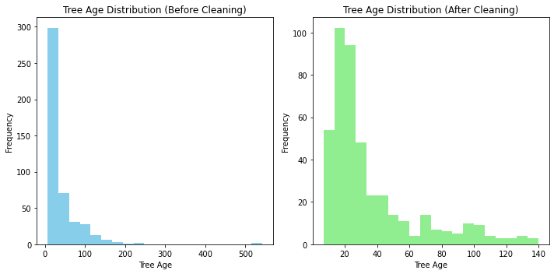
Forest Fire Prediction Using ML- Result
2. Project Methodology Data collection Data Exploration and Preprocessing (Data Cleaning) Split Dataset into Train(80%), Validate(10%), and Test(10%) ('Logistic Regression', 'Decision Tree', 'Neural Network’) Model Building (Define Model Train and Hyper Parameters Tuning) Model Evaluation & Confusion Matrix (final model chosen and evaluate performance metrics and Analyse Result) Conclusion and Reference 4. Data Preparation The variable chosen to clean is the Tree Age. Outlier and missing value noticed. See below the two-histogram used for cleaning after/before. Data cleaning operations carried out: Replaced negative Tree age values (<0) and (>150) with NaN (assumed to be errors). | 3 Variables Say which variables you used in your model, and whether you treated then as numeric or categorical. Explain the impact your choices will have on the models you build. You can use a table: Humidity consequence: Treating humidity as numeric enables the model to embrace the continuous nature of humidity levels, potentially enhancing its ability to generalize across different humidity ranges. Fire consequence on the model: Treating fire as categorical indicates the binary outcome of fire occurrence, which is crucial for classification tasks.
5. Model Training and Hyper Parameters A table showing the different models and hyper parameters you trained, along with the correct metric for each; Add a sentence on how you chose the hyper parameter values. Make sure you name the metric correctly. | Model Hyper Parameters
6. Final Model and Results Say how you chose the final model to test, and how you trained that model. Param: used RandomForestClassifier(max_depth=5, n_estimators=50) Explain what the confusion matrix tells us. True Positive (TP): 51 Instances where the model correctly predicts "Good" and actual class is "Good". False Negative (FN): 3 Instances where the model incorrectly predicts "Bad" and actual class is "Good". False Positive (FP): 6 Instances where the model incorrectly predicts "Good" when the actual class is "Bad". In this table. True Negative (TN): 32 Instances where the model correctly predicts "Bad" and actual class is "Bad". From this confusion matrix, we can derive various evaluation metrics such as accuracy, precision, recall, and F1-score
Variable | Type
humidity | Numeric
Fire | Categorical (but type on the dataset It’s a binary indicator of fire occurrence. Whether a fire happens (0 = no fire, 1 = fire). )
Accuracy: Accuracy quantifies the overall correctness of the model's predictions. In this instance, both Random Forest and Gradient Boosting models achieved best accuracies
Precision: These values signify the reliability of positive predictions made by each model.
Recall: These values underscore the models' ability to accurately identify positive instances.
F1 Score: These scores indicate the overall effectiveness of each model in correctly identifying positive instances while minimizing false positives.
Model | Hyper Parameters | Validation Metric
Random Forest | {'max_depth': 5, 'n_estimators': 150} | Accuracy-90%, precision-91%, recall-84%, F1-87%
Gradient Boosting | {'learning_rate': 0.1, 'n_estimators': 50} | Accuracy-92%, precision-92%, recall-89%, F1-91%
7. References
Book Research:
Forest Fire Prediction Using Machine Learning Techniques: A Systematic Literature Review" by A. A. Alhussein, R. Khare, and M. S. Oliya.
Online Resources:
ChatGPT: for correction of code, identifying error on code and for better understanding of code algorithm.
Kaggle Kernels: Explore notebooks and code shared by the data science community on various topics, including forest fire prediction.
stackoverflow.com: for correction of code, identifying error on code and for better understanding of code algorithm. Library installation syntax.
Actual / Predicted | Good | Bad
Good | 51 | 3
Bad | 6 | 32

